Slide 1

PROFFORMANCE
Assessment Tool and Incentive Systems
for Developing Higher Education Teachers' Performance
Info Session on
PROFFORMANCE Assessment Tool - Institutional Pilot testing
23rd November 2021, 15.00 CET
Zoom: https://us02web.zoom.us/j/89472139428?pwd=OFllcEJKYm0yS1AxZzg1cDFxQnpkZz09
Invitees: Higher education teachers and professionals in Austria, Croatia, Czechia, Georgia, Hungary, Serbia

Slide 2














PROFFORMANCE consortium
Coordinators:
Full Partners:
Associated Partners::
Notes:
Jobb felbontású logókat kérünk szépen

Slide 3
Main goals and rationale of the project
Quality enhancement of teaching and learning
through the development of teachers’ performance.
HEIs / Teachers’
needs and opportunities
Policy requirements
(EHEA, EU, EEA, national)
Impact
Development plans

Slide 4

Benchmarking Survey
2020 November – online survey: 156 respondent HEIs
Results: benchmarks, recommendations
    HEI level strategies for teaching and learning
    Performance management systems (HR, promotion, devlopment, incentives etc.)
    Involving students: creating a culture of „listening”
Final Report
profformance.eu/benchmarking

Slide 5
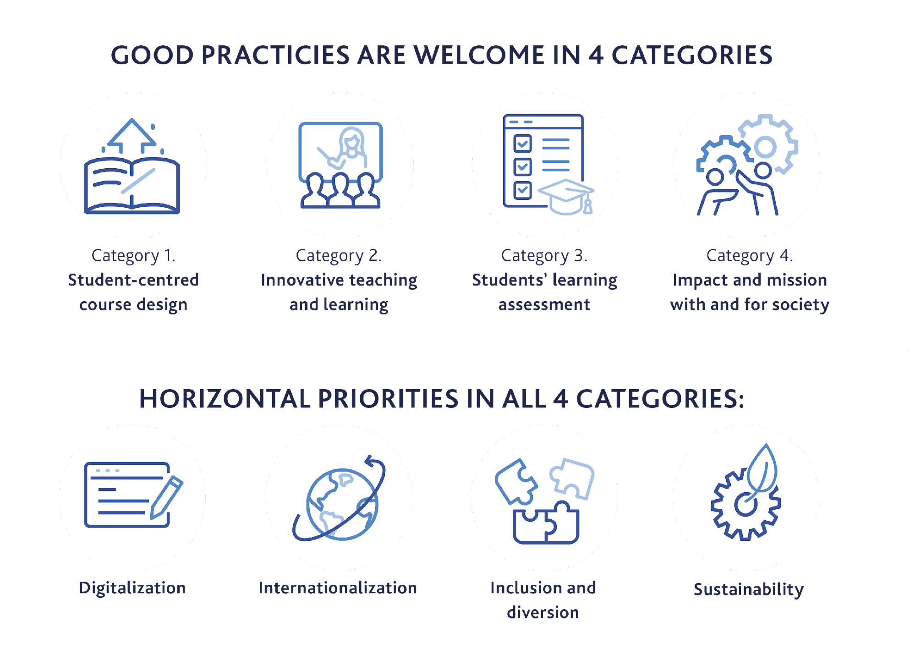
International HE Teacher Award
In PROFFORMANCE partner countries
Aims
  PROFFORMANCE network
  Identify and acknowlegde good practices
  Share and exchange best examples
  Cooperation between EHEA HEIs
  Promotion: best practice platform
profformance.eu/call-for-application

Slide 6
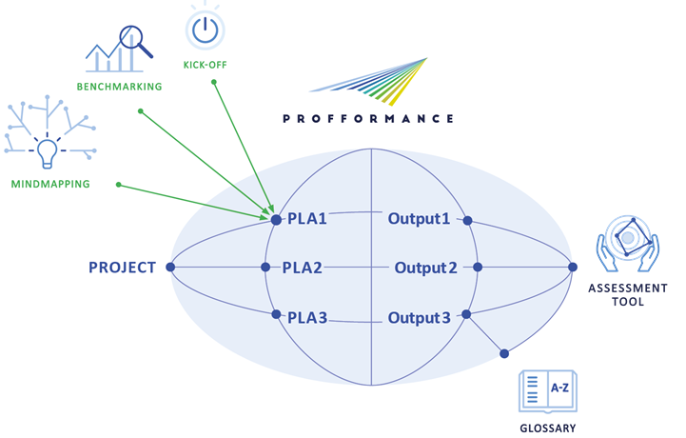
Tool development process

Slide 7
3D Assessment Tool
THEMATIC AREAS
Curriculum/course design
Teaching and learning
Assessing of students’ learning
Professional development
R&I, social responsibility
Organization- administration
HORIZONTAL ASPECTS
Internationalization
Digitalization
Inclusion
Sustainability
  PILOTS
Launch in November 2021
AIM
Evidence based decision making
Quality assurance
Strategic planning
Data on strengths & weaknesses
ASSESSORS
Self
Peers
Managers
Students
External stakeholders

Slide 8
Thematic Areas and Questions
TA1 – Curriculum/Course Design and Development (9 Q, Student 5 Q)
TA2 – Teaching Performance and the Student’s Learning Support (12 Q, Student 8 Q)
TA3 – Assessing the Student's Learning (8 Q, Student 5 Q)
TA4 – Professional Development for the Quality of Teaching (10 Q)
TA5 – Teaching-related Research, Innovation and Social Responsibility (13 Q, St 6 Q)
TA6 – Organizational and Administrative Tasks (just Self 11 Q, Student 3 Q)
3 horizontal dimensions:
Digitalisation
Internationalisation
Inclusion and diversity
10 level scale + not relevant (flexibility)
Self version - contains 6 thematic areas with average 10 questions each + feedback questions
Peer version - contains 5 thematic areas with average 10 questions each + feedback
Student version - 27 questions altogether + feedback questions

Slide 9
The test version of the assessment tool
contains 3 elements in English:
1.Self-assessment questionnaire - deadline: 20th January 2022
- to be completed individually by the teacher,
- filling time approx. 20 minutes,
- Access link: Self version
2.Peer-assessment questionnaire - deadline: 20th January 2022
- to be completed by two colleagues in the frame of a mutual interview
- filling time approx. 60 minutes (professional discussion + completion),
- Access link: Peer version
3. Student feedback questionnaire - deadline: last lesson in first semester
- students complete preferably during the last lesson,
- filling time approx. 20 minutes
- Access link: Student version

Slide 10
Peer-assessment questionnaire
This PEER version of the assessment tool aims to promote mutual learning and exchange of experience between peer teachers in your institution.
It could serve as a mirror on your activities related to teaching. You may get feedback from your peers which might help you to develop efficiency of T&L, and it facilitates cooperation as well.
First please fill in the self-assessment questionnaire, then choose a peer with whom you would mutually implement the peer assessment on each other.
At least one lesson visit would be helpful, but optional (can be online as well)

Slide 11
Why to participate?
For HEIs:
complementing or embedded into QA systems
teacher performance management culture
data for evidence-based decision making, strategic planning
assessment for development (formative)
benchmarks - aggregated data - not for ranking
competence-based - complex roles of HE teachers
tool for QA in int’l cooperations, projects, joint/double degrees, European University Alliances

Slide 12
Why to participate?
For HE teachers:
self-assessment and feedback from different stakeholders
exchange of good practices, promoting cooperation between colleagues
mapping competence, base for career development and promotion
NOW: certificate on the participation in the pilot testing

Slide 13
Schedule of piloting
23rd November 2021 3.00 PM CET ZOOM webinar to be registered and distributed | Introductory meeting explanation of the testing process for institutions 1. presentation of the tool 2. guidelines for testing 3. QA | All partners and HEI representatives
24th November 2021 - 20th January 2022 | Testing within the institutions | HEIs with technical assistance of respective partners
End January 2022 | Interviews and feedback with/from participating HEIs | All partners and HEIs + PROFFORMANCE experts - CWG

Slide 14
Methodology of the pilot testing
1. Partners and HEIs agree on pilot implementation
2. HEI receives preliminary material
3. HEI appoints a responsible person for the implementation of the testing | Name of responsible person
4. International introductory meeting - 23rd November 2021 3.00 PM CET | Participants:
5. Selection of testers - ideally, but can be adjusted to local and institutional context | 16 teachers try all 3 versions of the tool Peer reviewers - 8 pairs of peers - mutual interviews Students of 1 course of each participating teachers Larger number of teachers - for self review if this is possible

Slide 15
Methodology of the pilot testing
6. Code distribution - OPTIONAL - question of anonymisation | Codes are distributed by HEI (to teachers and students) - they use only the code in the questionnaire or they skip that field
7. Start of implementation from 24th November | Introductory meeting within the Institution
8. Implementation between 24th November 2021- 20th January 2022 | Self version can be filled in individually Peer version should be discussed between peers paired together OPTIONALLY one lesson visit would be helpful (can be online as well) Student version can be filled during a lesson of the teacher
9. Data collected in a central database | Filtered data will be sent to institutions
10. Feedbacks analysed | Within institutions + By the PROFFORMANCE consortium
11. Feedback exchange meeting in January 2022 | Participant HEIs

Slide 16
Thank you for your kind attention!
https://profformance.eu/

